Slide 1


University Physics
Chapter 10 DIRECT-CURRENT CIRCUITS
PowerPoint Image Slideshow

Slide 2

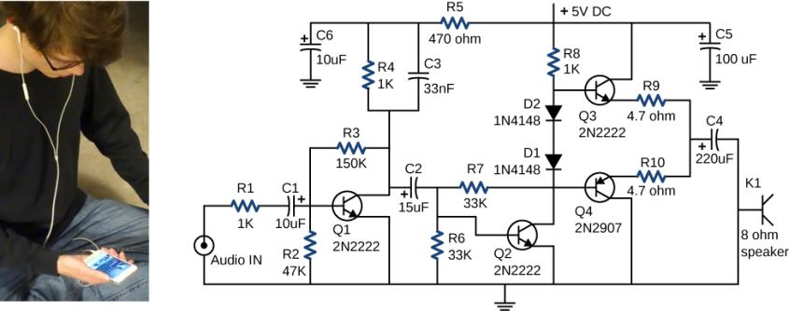
Figure 10.1
This circuit shown is used to amplify small signals and power the earbud speakers attached to a cellular phone. This circuit’s components include resistors, capacitors, and diodes, all of which have been covered in previous chapters, as well as transistors, which are semi-conducting devices covered in Condensed Matter Physics (http://cnx.org/content/m58591/latest/). Circuits using similar components are found in all types of equipment and appliances you encounter in everyday life, such as alarm clocks, televisions, computers, and refrigerators. (credit: Jane Whitney)

Slide 3
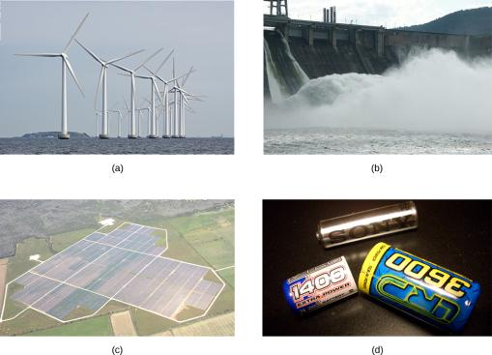
Figure 10.2
A variety of voltage sources. (a) The Brazos Wind Farm in Fluvanna, Texas; (b) the Krasnoyarsk Dam in Russia; (c) a solar farm; (d) a group of nickel metal hydride batteries. The voltage output of each device depends on its construction and load. The voltage output equals emf only if there is no load. (credit a: modification of work by “Leaflet”/Wikimedia Commons; credit b: modification of work by Alex Polezhaev; credit c: modification of work by US Department of Energy; credit d: modification of work by Tiaa Monto)

Slide 4
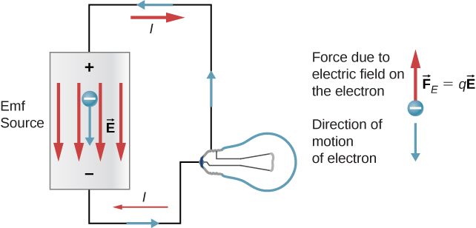
Figure 10.3
A source of emf maintains one terminal at a higher electric potential than the other terminal, acting as a source of current in a circuit.

Slide 5
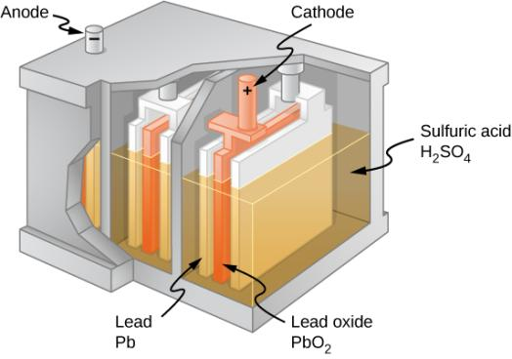
Figure 10.4
Chemical reactions in a lead-acid cell separate charge, sending negative charge to the anode, which is connected to the lead plates. The lead oxide plates are connected to the positive or cathode terminal of the cell. Sulfuric acid conducts the charge, as well as participates in the chemical reaction.

Slide 6
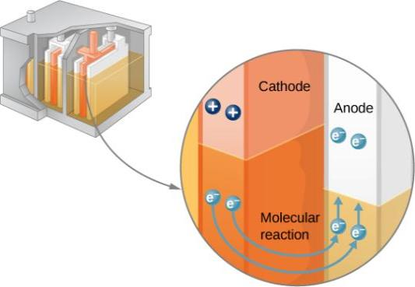
Figure 10.5
In a lead-acid battery, two electrons are forced onto the anode of a cell, and two electrons are removed from the cathode of the cell. The chemical reaction in a lead-acid battery places two electrons on the anode and removes two from the cathode. It requires a closed circuit to proceed, since the two electrons must be supplied to the cathode.

Slide 7
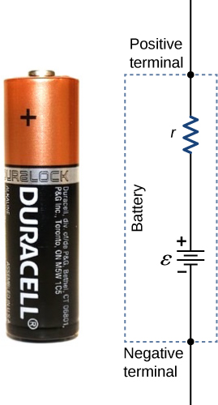
Figure 10.6
A battery can be modeled as an idealized emf (ε) with an internal resistance (r). The terminal voltage of the battery is V_{terminal} = ε − Ir.

Slide 8
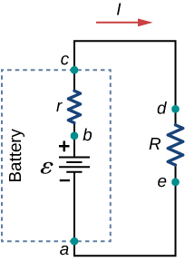
Figure 10.7
Schematic of a voltage source and its load resistor R. Since the internal resistance r is in series with the load, it can significantly affect the terminal voltage and the current delivered to the load.

Slide 9
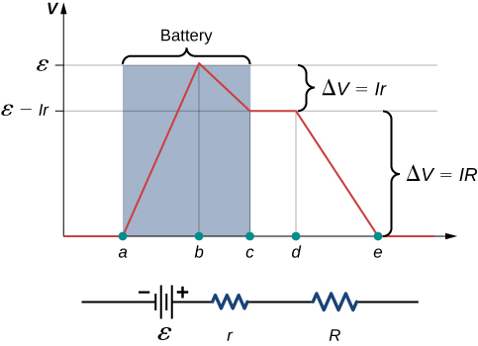
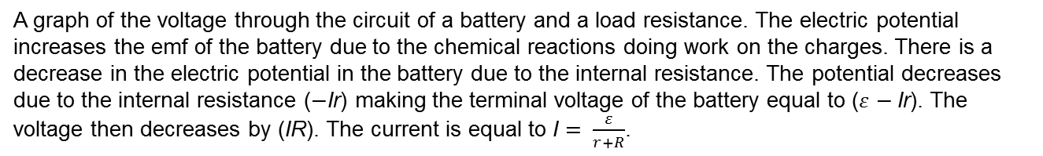
Figure 10.8
A graph of the voltage through the circuit of a battery and a load resistance. The electric potential increases the emf of the battery due to the chemical reactions doing work on the charges. There is a decrease in the electric potential in the battery due to the internal resistance. The potential decreases due to the internal resistance (−Ir) making the terminal voltage of the battery equal to ($ε$ − Ir). The voltage then decreases by (IR). The current is equal to I $= \frac{ε}{r+R}$.

Slide 10
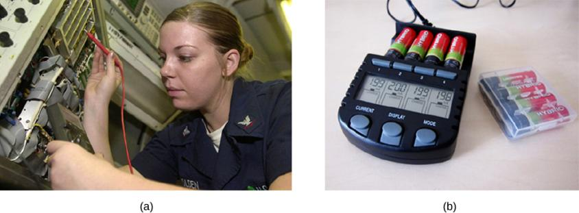
Figure 10.9
Battery testers measure terminal voltage under a load to determine the condition of a battery.
A US Navy electronics technician uses a battery tester to test large batteries aboard the aircraft carrier USS Nimitz. The battery tester she uses has a small resistance that can dissipate large amounts of power.
The small device shown is used on small batteries and has a digital display to indicate the acceptability of the terminal voltage. (credit a: modification of work by Jason A. Johnston; credit b: modification of work by Keith Williamson)

Slide 11
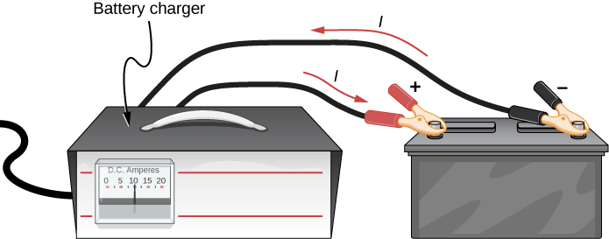
Figure 10.10
A car battery charger reverses the normal direction of current through a battery, reversing its chemical reaction and replenishing its chemical potential.

Slide 12
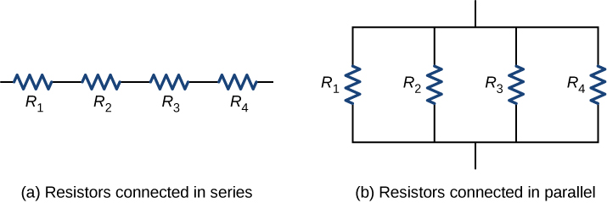
Figure 10.11
For a series connection of resistors, the current is the same in each resistor.
For a parallel connection of resistors, the voltage is the same across each resistor.

Slide 13
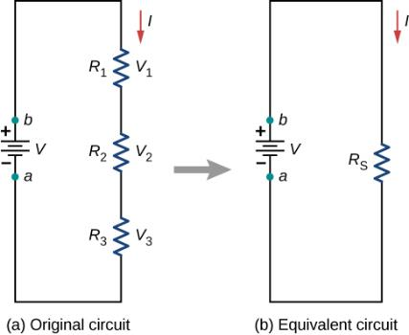
Figure 10.12
Three resistors connected in series to a voltage source.
The original circuit is reduced to an equivalent resistance and a voltage source.

Slide 14
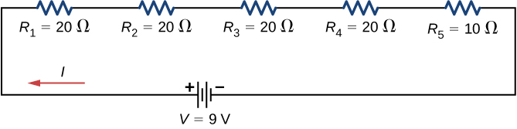
Figure 10.13
A simple series circuit with five resistors.

Slide 15
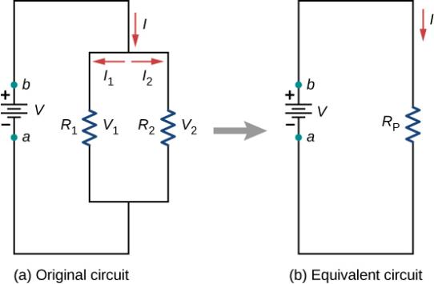
Figure 10.14
Two resistors connected in parallel to a voltage source.
The original circuit is reduced to an equivalent resistance and a voltage source.

Slide 16
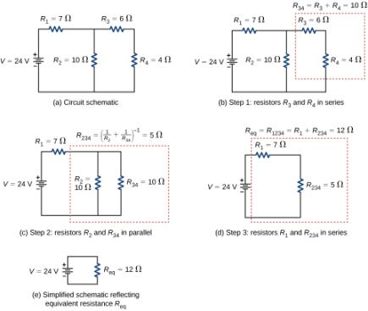
Figure 10.15
The original circuit of four resistors.
Step 1: The resistors R₃ and R₄ are in series and the equivalent resistance is R₃₄ = 10 Ω.
Step 2: The reduced circuit shows resistors R₂ and R₃₄ are in parallel, with an equivalent resistance of R₂₃₄ = 5 Ω.
Step 3: The reduced circuit shows that R₁ and R₂₃₄ are in series with an equivalent resistance of R₁₂₃₄ = 12Ω, which is the equivalent resistance R_{eq}.
The reduced circuit with a voltage source of V = 24 V with an equivalent resistance of R_{eq} = 12 Ω. This results in a current of I = 2 A from the voltage source.

Slide 17

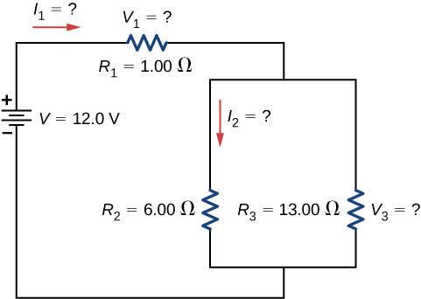
Figure 10.16
These three resistors are connected to a voltage source so that R₂ and R₃ are in parallel with one another and that combination is in series with R₁.

Slide 18
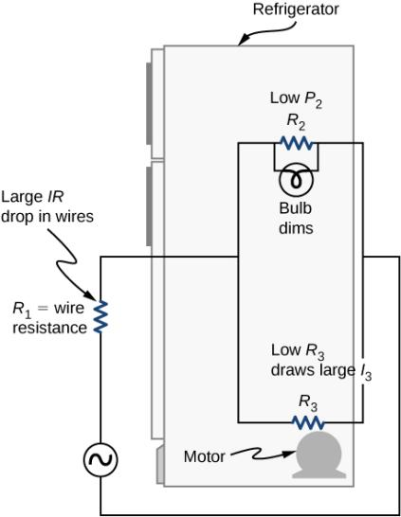
Figure 10.17
Why do lights dim when a large appliance is switched on? The answer is that the large current the appliance motor draws causes a significant IR drop in the wires and reduces the voltage across the light.

Slide 19
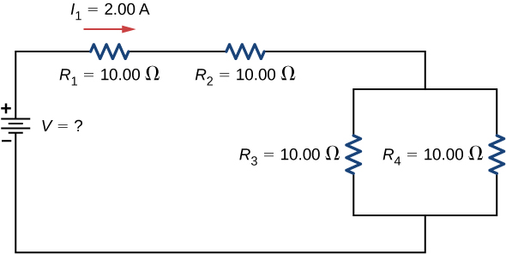
Figure 10.18
To find the unknown voltage, we must first find the equivalent resistance of the circuit.

Slide 20
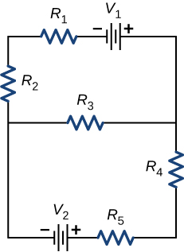
Figure 10.19
This circuit cannot be reduced to a combination of series and parallel connections. However, we can use Kirchhoff’s rules to analyze it.

Slide 21
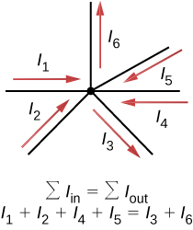
Figure 10.20
Charge must be conserved, so the sum of currents into a junction must be equal to the sum of currents out of the junction.

Slide 22
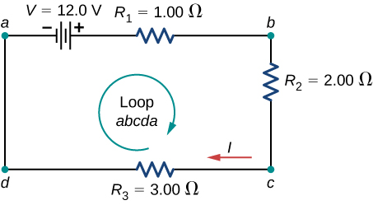
Figure 10.21
A simple loop with no junctions. Kirchhoff’s loop rule states that the algebraic sum of the voltage differences is equal to zero.

Slide 23
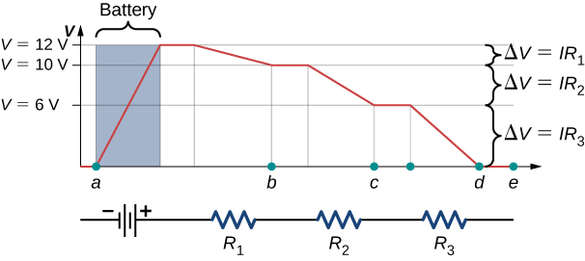
Figure 10.22
A voltage graph as we travel around the circuit. The voltage increases as we cross the battery and decreases as we cross each resistor. Since the resistance of the wire is quite small, we assume that the voltage remains constant as we cross the wires connecting the components.

Slide 24
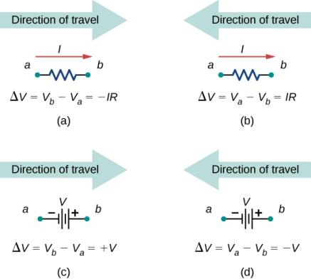
Figure 10.23
Each of these resistors and voltage sources is traversed from a to b.
When moving across a resistor in the same direction as the current flow, subtract the potential drop.
When moving across a resistor in the opposite direction as the current flow, add the potential drop.
When moving across a voltage source from the negative terminal to the positive terminal, add the potential drop.
When moving across a voltage source from the positive terminal to the negative terminal, subtract the potential drop.

Slide 25
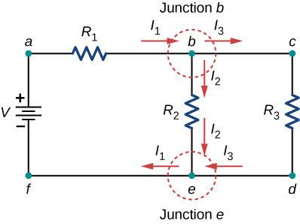
Figure 10.24
At first glance, this circuit contains two junctions, Junction b and Junction e, but only one should be considered because their junction equations are equivalent.

Slide 26
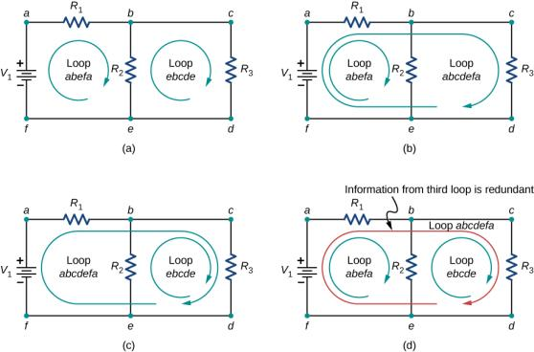
Figure 10.25
Panels (a)–(c) are sufficient for the analysis of the circuit. In each case, the two loops shown contain all the circuit elements necessary to solve the circuit completely. Panel (d) shows three loops used, which is more than necessary. Any two loops in the system will contain all information needed to solve the circuit. Adding the third loop provides redundant information.

Slide 27
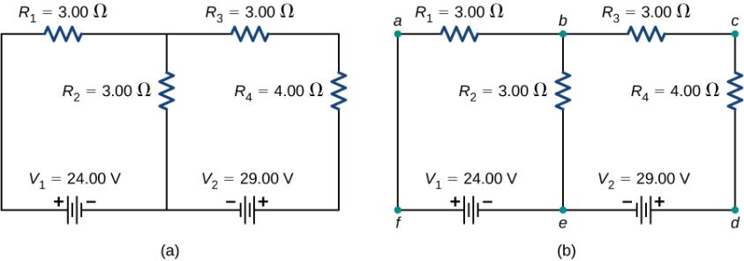
Figure 10.26
A multi-loop circuit.
Label the circuit to help with orientation.

Slide 28
Figure 10.27
This circuit has two junctions, labeled b and e, but only node b is used in the analysis.
Labeled arrows represent the currents into and out of the junctions.

Slide 29
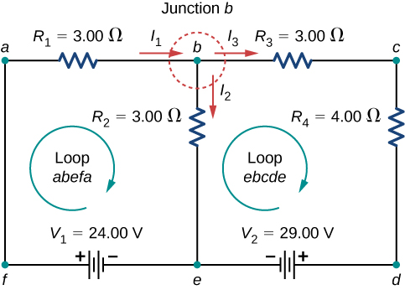
Figure 10.28
Choose the loops in the circuit.

Slide 30
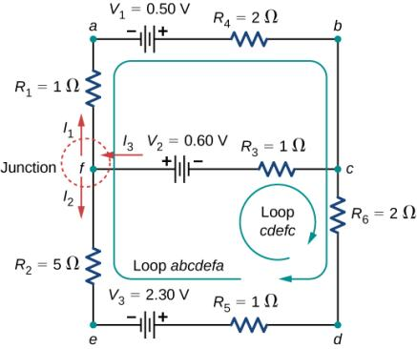
Figure 10.29
This circuit is combination of series and parallel configurations of resistors and voltage sources. This circuit cannot be analyzed using the techniques discussed in Electromotive Force but can be analyzed using Kirchhoff’s rules.

Slide 31
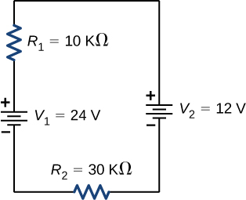
Exercise 10.6

Slide 32
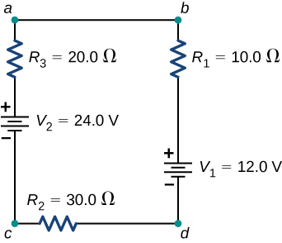
Figure 10.30
This circuit consists of three resistors and two batteries connected in series. Note that the batteries are connected with opposite polarities.

Slide 33
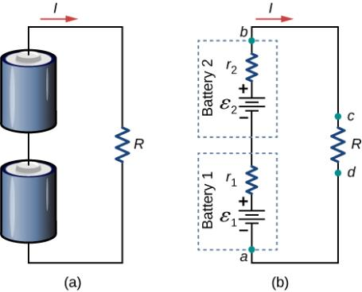
Figure 10.31
Two batteries connected in series with a load resistor.
The circuit diagram of the two batteries and the load resistor, with each battery modeled as an idealized emf source and an internal resistance.

Slide 34
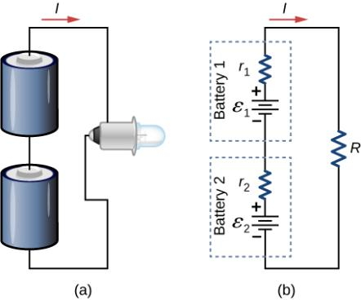
Figure 10.32
Two batteries connect in series to an LED bulb, as found in a flashlight.

Slide 35
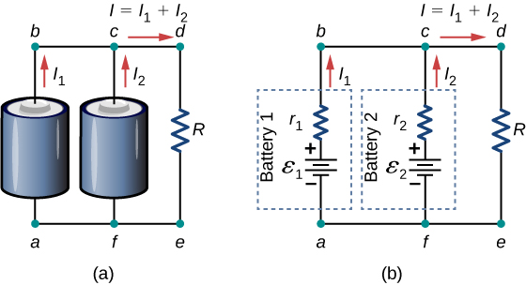
Figure 10.33
Two batteries connect in parallel to a load resistor.
The circuit diagram shows the shows battery as an emf source and an internal resistor. The two emf sources have identical emfs (each labeled by ε) connected in parallel that produce the same emf.

Slide 36
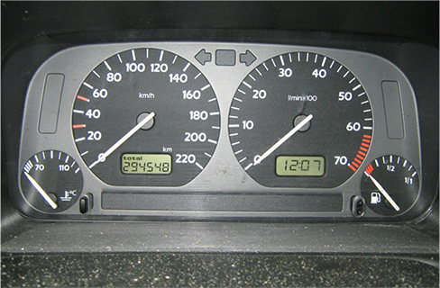
Figure 10.34
The fuel and temperature gauges (far right and far left, respectively) in this 1996 Volkswagen are voltmeters that register the voltage output of “sender” units. These units are proportional to the amount of gasoline in the tank and to the engine temperature. (credit: Christian Giersing)

Slide 37
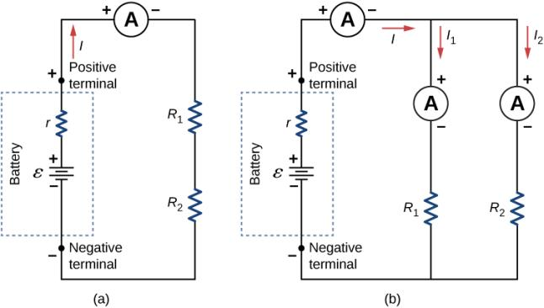
Figure 10.35
When an ammeter is used to measure the current through two resistors connected in series to a battery, a single ammeter is placed in series with the two resistors because the current is the same through the two resistors in series.
When two resistors are connected in parallel with a battery, three meters, or three separate ammeter readings, are necessary to measure the current from the battery and through each resistor. The ammeter is connected in series with the component in question.

Slide 38
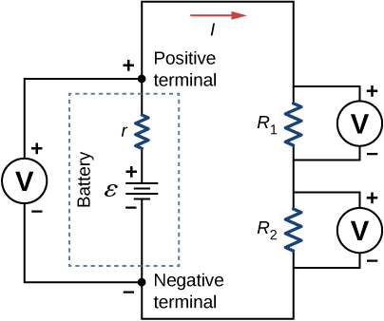
Figure 10.36
To measure potential differences in this series circuit, the voltmeter (V) is placed in parallel with the voltage source or either of the resistors. Note that terminal voltage is measured between the positive terminal and the negative terminal of the battery or voltage source. It is not possible to connect a voltmeter directly across the emf without including the internal resistance r of the battery.

Slide 39
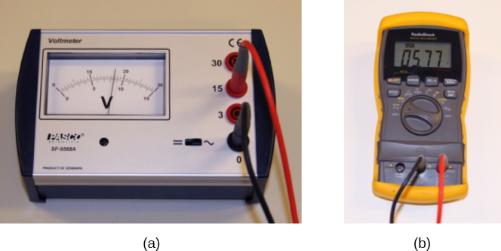
Figure 10.37
An analog voltmeter uses a galvanometer to measure the voltage.
Digital meters use an analog-to-digital converter to measure the voltage. (credit a and credit b: Joseph J. Trout)

Slide 40
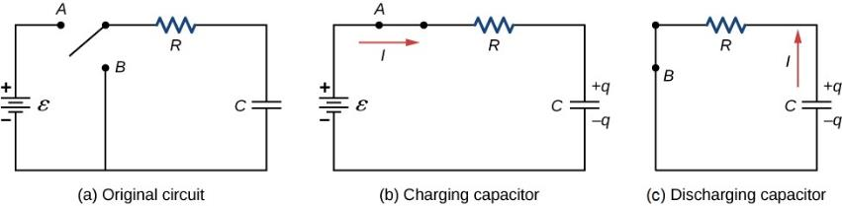
Figure 10.38
An RC circuit with a two-pole switch that can be used to charge and discharge a capacitor.
When the switch is moved to position A, the circuit reduces to a simple series connection of the voltage source, the resistor, the capacitor, and the switch.
When the switch is moved to position B, the circuit reduces to a simple series connection of the resistor, the capacitor, and the switch. The voltage source is removed from the circuit.

Slide 41
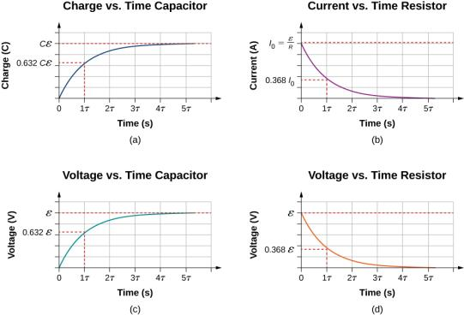
Figure 10.39
Charge on the capacitor versus time as the capacitor charges.
Current through the resistor versus time.
Voltage difference across the capacitor.
Voltage difference across the resistor.

Slide 42
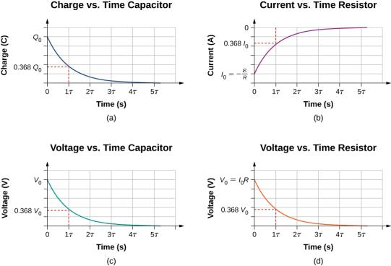
Figure 10.40
Charge on the capacitor versus time as the capacitor discharges.
Current through the resistor versus time.
Voltage difference across the capacitor.
Voltage difference across the resistor.

Slide 43
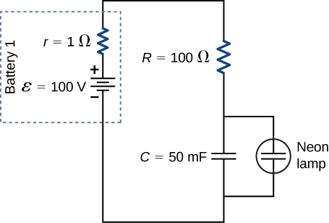
EXAMPLE 10.8

Slide 44
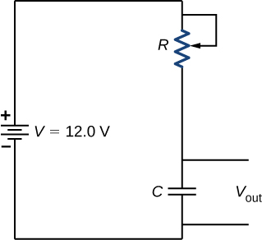
Example 10.9

Slide 45
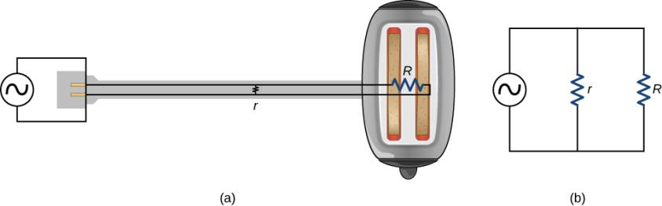
Figure 10.41
A short circuit is an undesired low-resistance path across a voltage source.
Worn insulation on the wires of a toaster allow them to come into contact with a low resistance r. Since P = V²/r, thermal power is created so rapidly that the cord melts or burns.
A schematic of the short circuit.

Slide 46
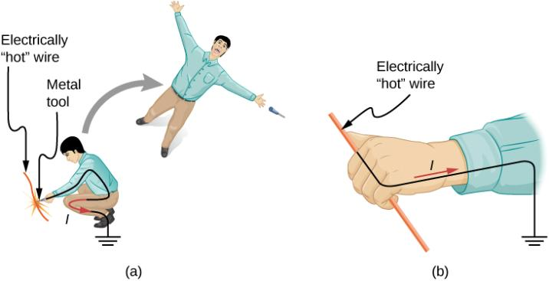
Figure 10.42
An electric current can cause muscular contractions with varying effects.
The victim is “thrown” backward by involuntary muscle contractions that extend the legs and torso.
The victim can’t let go of the wire that is stimulating all the muscles in the hand. Those that close the fingers are stronger than those that open them.

Slide 47
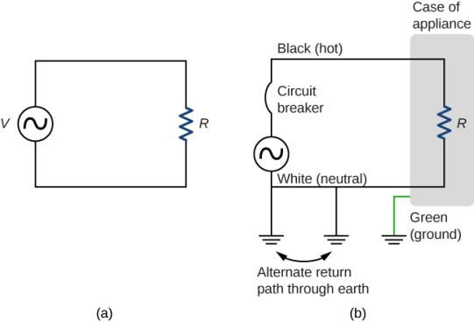
Figure 10.43
Schematic of a simple ac circuit with a voltage source and a single appliance represented by the resistance R. There are no safety features in this circuit.
The three-wire system connects the neutral wire to ground at the voltage source and user location, forcing it to be at zero volts and supplying an alternative return path for the current through ground. Also grounded to zero volts is the case of the appliance. A circuit breaker or fuse protects against thermal overload and is in series on the active (live/hot) wire.

Slide 48
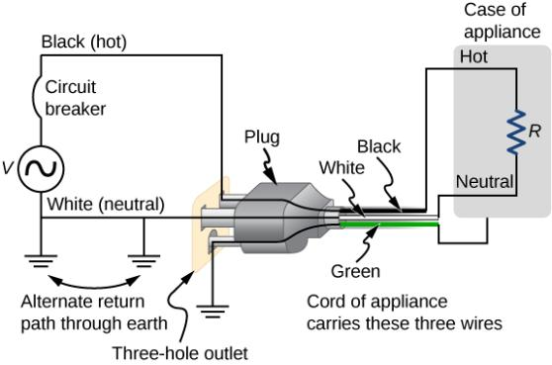
Figure 10.44
The standard three-prong plug can only be inserted in one way, to ensure proper function of the three-wire system.

Slide 49
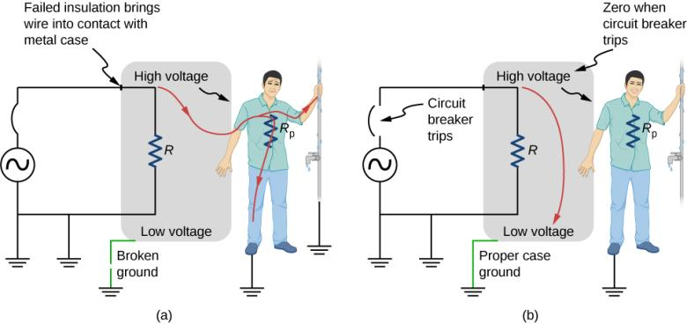
Figure 10.45
Worn insulation allows the live/hot wire to come into direct contact with the metal case of this appliance.
The ground connection being broken, the person is severely shocked. The appliance may operate normally in this situation.
With a proper ground, the circuit breaker trips, forcing repair of the appliance.

Slide 50
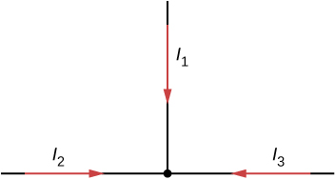
EXERCISE 8

Slide 51
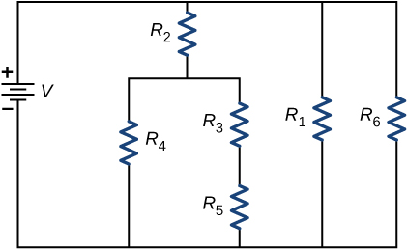
EXERCISE 9

Slide 52

Exercise 15

Slide 53

EXERCISE 35

Slide 54

Exercise 36

Slide 55

Exercise 37

Slide 56

EXERCISE 38

Slide 57

EXERCISE 39

Slide 58

EXERCISE 40

Slide 59

EXERCISE 41

Slide 60

EXERCISE 42

Slide 61

EXERCISE 43

Slide 62

EXERCISE 46

Slide 63

Exercise 48

Slide 64

EXERCISE 69

Slide 65

EXERCISE 72

Slide 66

Exercise 75

Slide 67

EXERCISE 77

Slide 68

EXERCISE 78

Slide 69

EXERCISE 79

Slide 70

EXERCISE 82

Slide 71

EXERCISE 85

Slide 72

Exercise 89

Slide 73

Exercise 90

Slide 74

Exercise 91

Slide 75

EXERCISE 92

Slide 76

EXERCISE 93

Slide 77

EXERCISE 94

Slide 78

EXERCISE 95

Slide 79

EXERCISE 96

Slide 80

This OpenStax ancillary resource is © Rice University under a CC-BY 4.0 International license; it may be reproduced or modified but must be attributed to OpenStax, Rice University and any changes must be noted.

